Slide 1
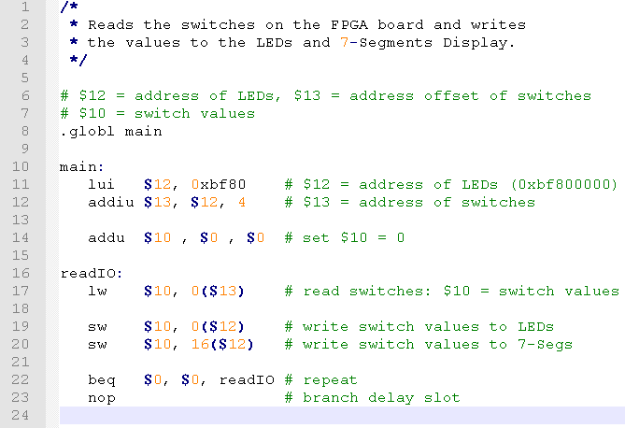
ReadSwitches:main.s

Slide 2
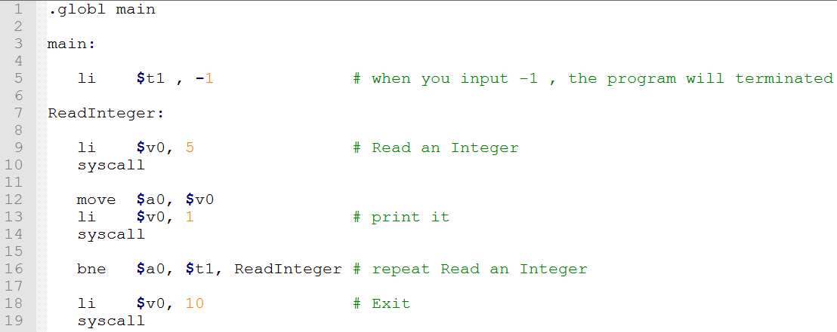
ReadSwitches:main.s
QtSpim

